Slide 1
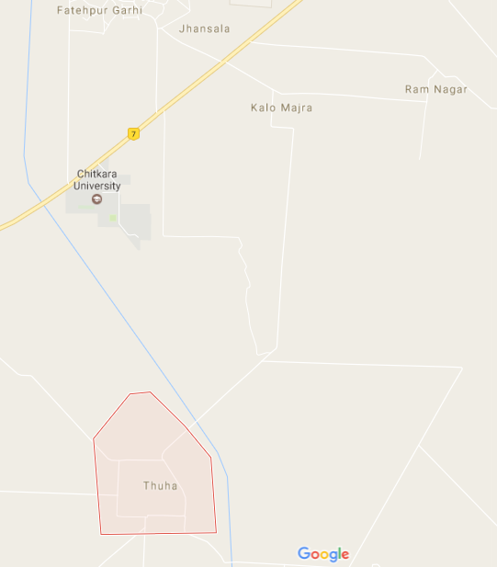
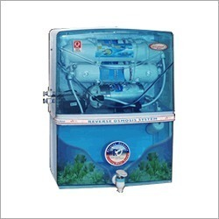
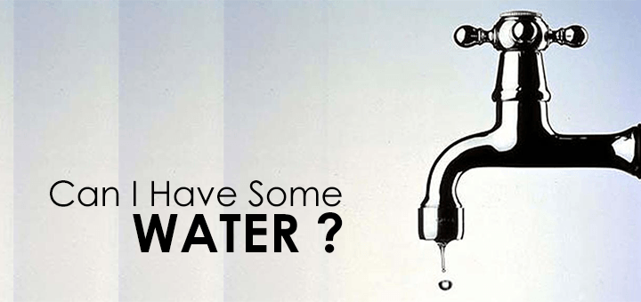

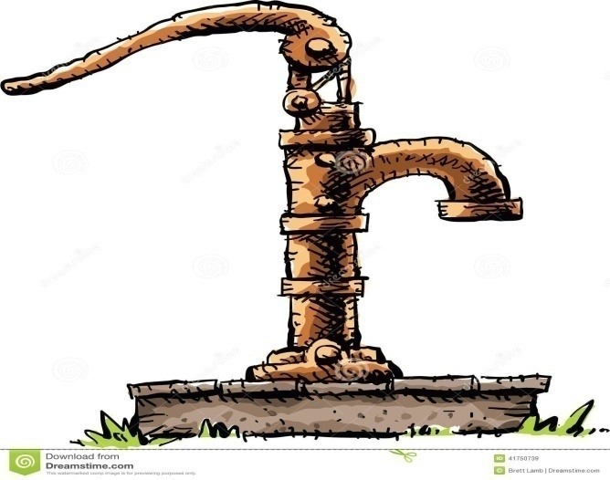

Integrated Project CSE-K-103
Assessment of Water Quality Parameters
Sources of Water | Dissolved Oxygen | C.O.D | PH | TDS | Residual Chlorine | Hardness
Tap Water | 11.2 | Negligible | 7.15 | 421 | No chlorine | 68
R.O Water | 21 | Negligible | 6.75 | 365 | No chlorine | 204.5
Well Water | 11.8 | Negligible | 7.2 | 330 | No chlorine | 105
Hand Pump Water | 9 | negligible | 6.75 | 456 | No chlorine | 1200
WHO STANDARD
1.Ph - 6.5-7.5
2.Dissolved oxygen – 18 ppm
3.Residual Chlorine-0.2 ppm
4.TDS-500 ppm
5.Hardness-300 ppm
Survey Location –
Village Thuha
Different Sources Of Water
Riya Puri | 1610991719
Rohan Arora | 1610991724
Rohan Gaur | 1610991725
Rudra shakti | 1610991736
Rupali Choudhary | 1610991737

